Slide 1





PROPOSAL
Earthly Touch Foundation
Gala Dinner Fundraiser Proposal
Gala Date: 8 November 2025
Prepared By
Earthly Touch Foundation (NPO)
BBBEE level 1
We acknowledge the below Partners

Slide 2
Introduction
Dear xxx
Thank you for the opportunity to connect.
We trust that this connection will ignite a partnership for fostering positive change in our communities & environment.
Earthly Touch Foundation (ETF) is a Non-Profit organisation founded in 2020.We are currently fully operational in Gauteng with ambitions to grow within South Africa and Africa.
Our main focus is to, contribute to the reduction of global warming through collection of waste plastic and repurposing it into eco-bricks which are then used for constructing educational buildings and other buildings for the benefit of the community.
Together with our partners Rotary Club of Morningside whose areas of focus includes education, environment, water and sanitation and Cherith Projects who focuses on sustainable and eco friendly construction are joining hands to make a positive impact in the reduction of global warming
The above is all in service of "saving tomorrow today", by taking care of our environment, enabling education of nations and unlocking community based skills development and training.

Slide 3
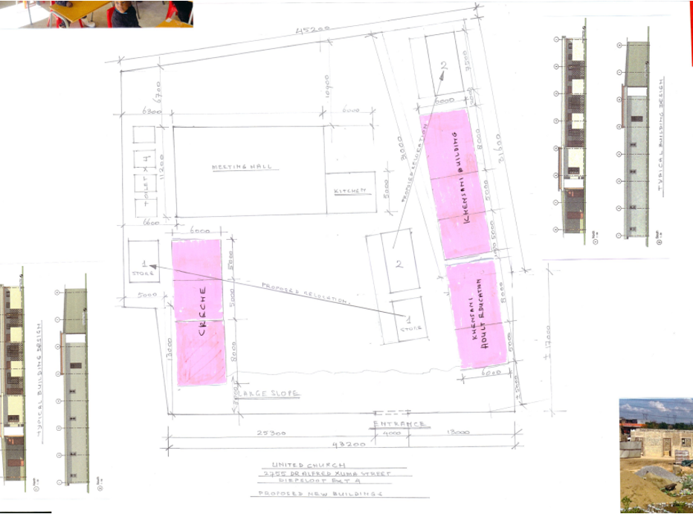
The Project – ECO Education Centre
Project Name: Eco Education Centre
Location: United Churches, Diepsloot Ext 4, Gauteng
NB: This is Earthly Touch Foundation’s 4th project, launched in
July 2025

Slide 4
The Project – ECO Education Centre
The project setup has commenced from July 2025
Specifications:
Total Site Area: 500m2 floor area (estimate)
Setup 3 Eco-Education Buildings on 348m2
floor area
ECD Centre
Khensani’s Collection extra lesson school
Vocational Training Centre
3 storerooms
2 Security Rooms
Sickbay
6 Ablutions
Community gardens
Environmental Sustainability Contribution
The centre will use 200 000 Eco bricks diverting 121 tons of waste plastic from the landfills
110 tCO₂ emission will be saved from the environment
Roof Rain Water harvesting
Solar powered, 10kW system
Recycling of food waste into compost

Slide 5
The Project – ECO Education Centre
Impact on Education
Access to better quality education by enabling
  +-200 children will benefit from the below
    Age 1-5 will access the ECD Centre
    Age grade 1 – 12 will benefit from extra lessons
    Technology training (Robotics, AI, Coding training)
  Playground access
Impact on Communities
Financial upliftment and inclusion by enabling
  +-50 jobs yearly to be created through vocational training focused on empowering women and youth
  Community gardening and education impacting +- 400 families
  Entrepreneurship training for both primary & high school students, and vocational centre trainees
  +- 30 jobs created during the construction process
  Over 2000 people will be involved in plastic pollution and ecobrick making awareness workshops

Slide 6
The Project – ECO Education Centre
Impact the Environment
Use of green principles for construction
Use of construction waste materials.
Use of solar instead of electricity generated power
Use of rain water
Recycling/upcycling of carpentry waste materials
Impact on Environment
Composting using food waste
Use of eco- toilets
Cleaning up events to keep the community free from litre
Upcycling/recycling of waste textile materials for our sewing projects
Use of non-compliant bottles for jewellery, décor and furniture making

Slide 7
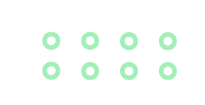
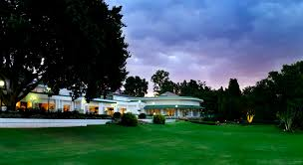
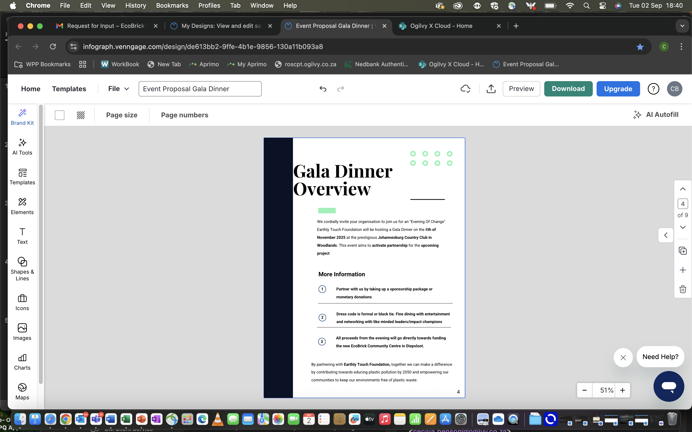
Gala Dinner Overview
We cordially invite your organisation to join us for an "Evening Of Change" Earthly Touch Foundation in partnership with Rotary Club of Morningside will be hosting a Gala Dinner on the 8th of November 2025 at the prestigious Johannesburg Country Club in Woodlands.
This event aims to activate partnership for the upcoming project.
All donations and proceeds will go towards the Eco Education Centre – Diepsloot Ext 4
More Information
Partner with us by taking a sponsorship package or monetary/building materials donations
Dress code theme is black tie.
Colour themes are green, gold and black
Entertainment I Raffles I Networking I Auctions

Slide 8
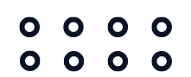
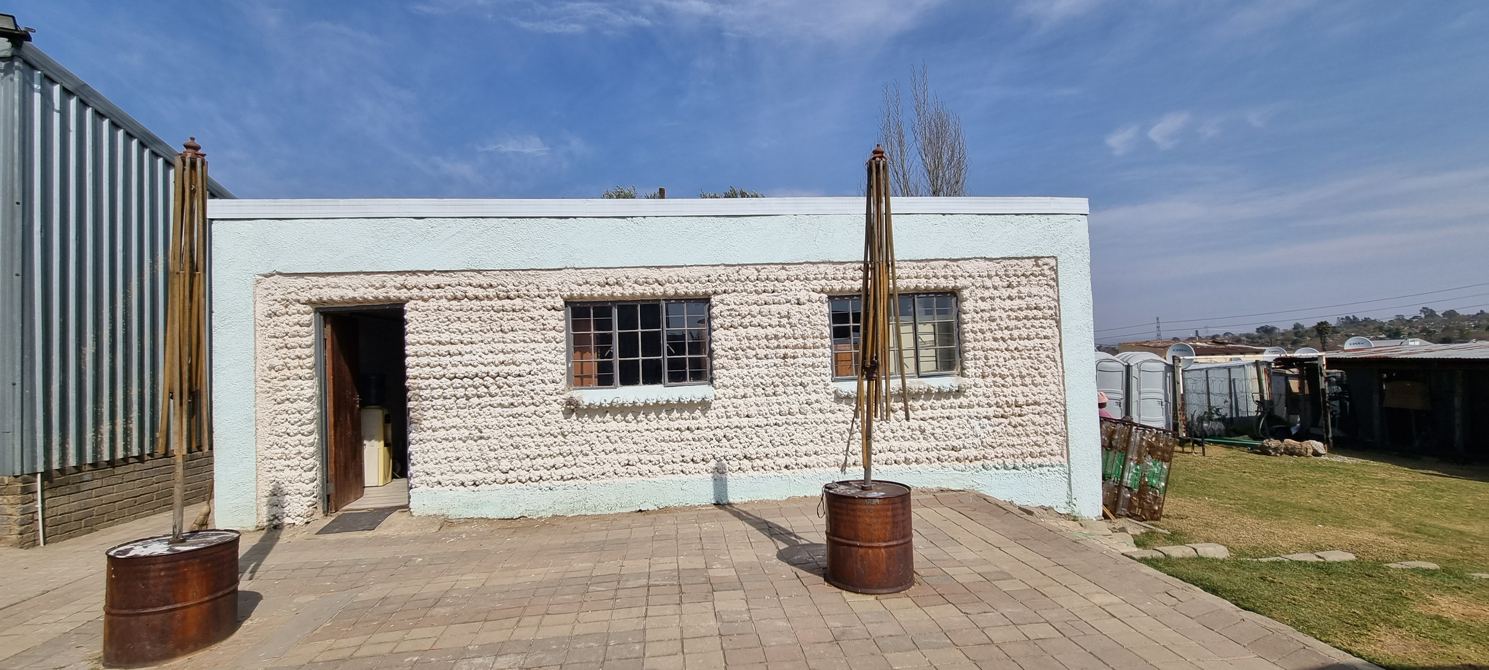
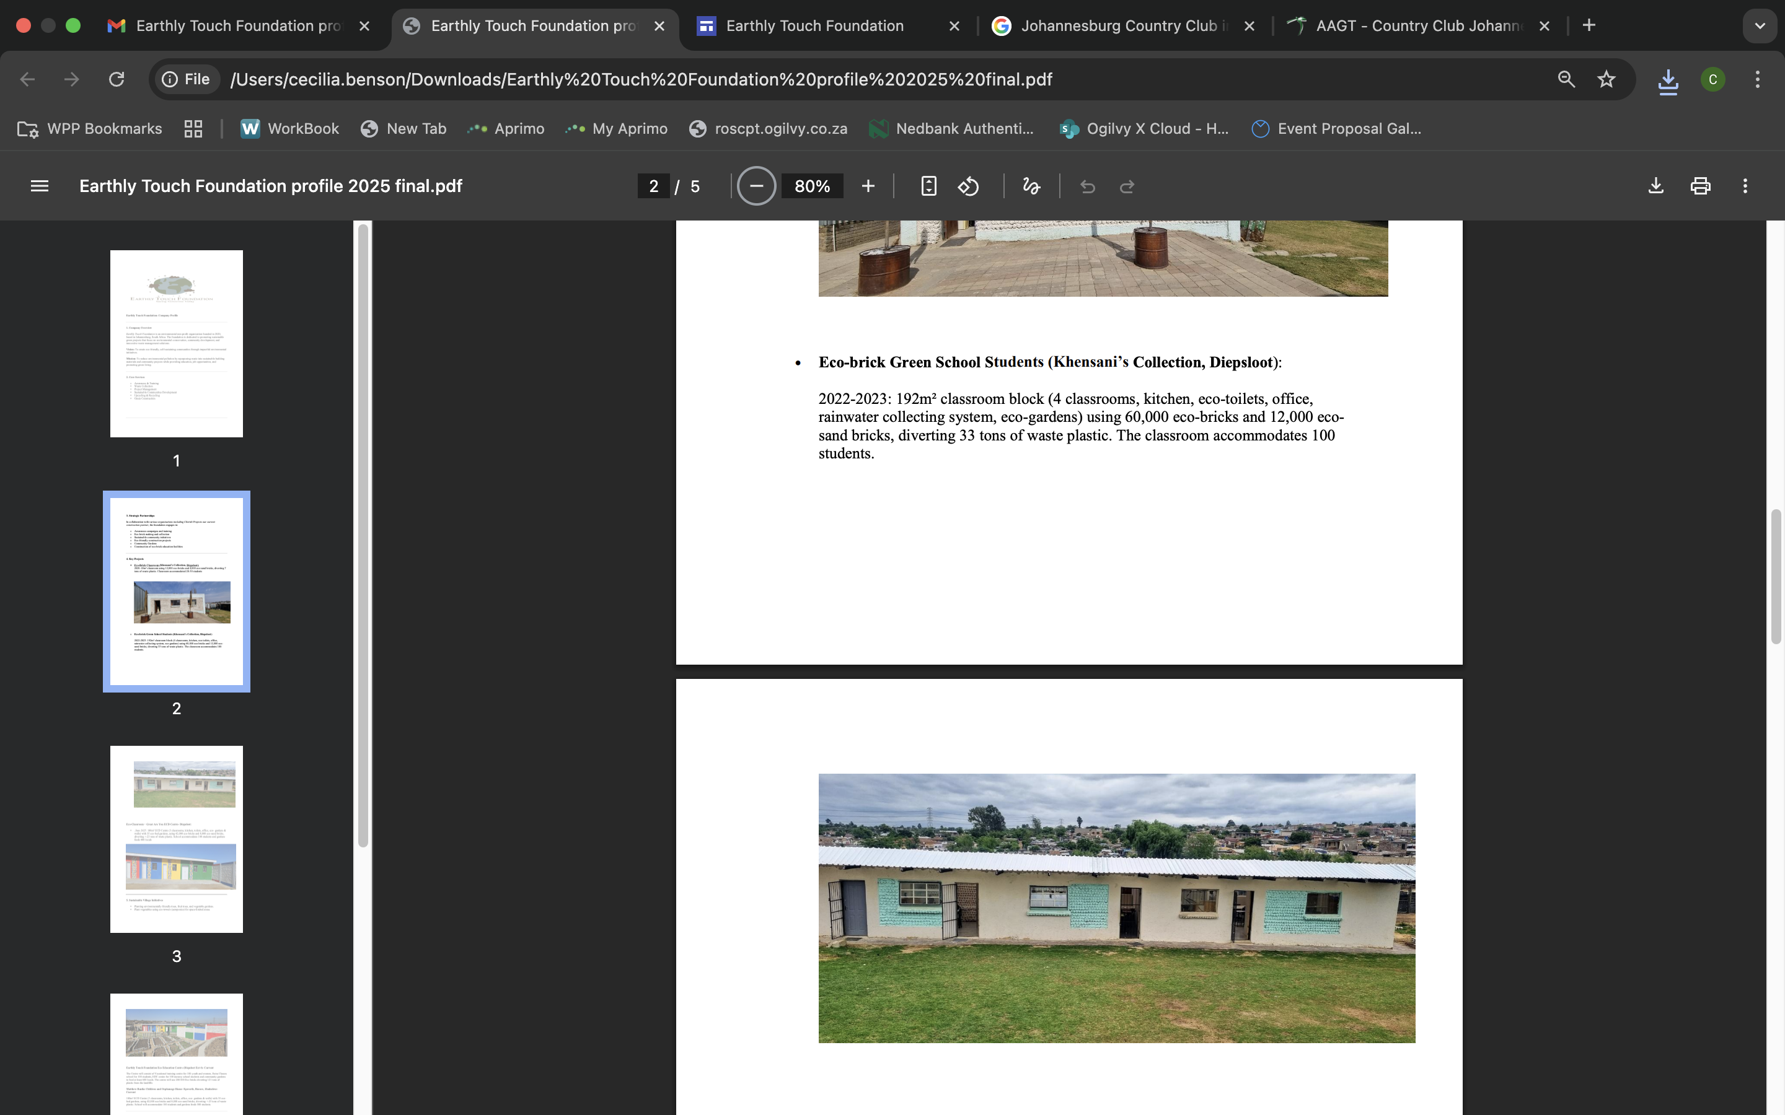
Our Impact
Highlights of Some Our Completed Projects
2020
2023
Eco-brick Classroom(Khensani’s Collection, Diepsloot Ext 6)
45 m² area classroom
12 000 eco-bricks
4000 Ecosands
7 tons waste plastic
Classroom accommodates 20-30 students
Eco-brick Classroom block(Khensani’s Collection, Diepsloot Ext 6)
192 m² area classroom, 4 classroom, kitchen, office, eco-toilets,
roof rain water harvesting, eco-gardens
60 000 eco-bricks
12 000 Ecosands
33 tons waste plastic
Classroom block accommodates 100 students

Slide 9
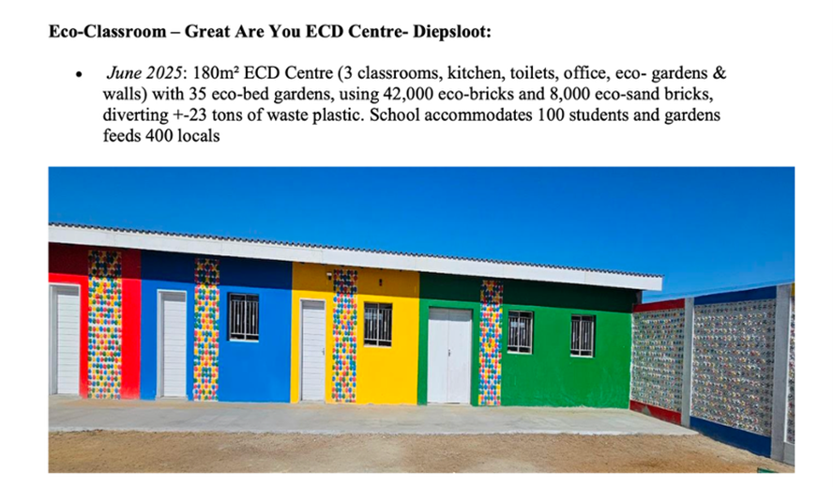
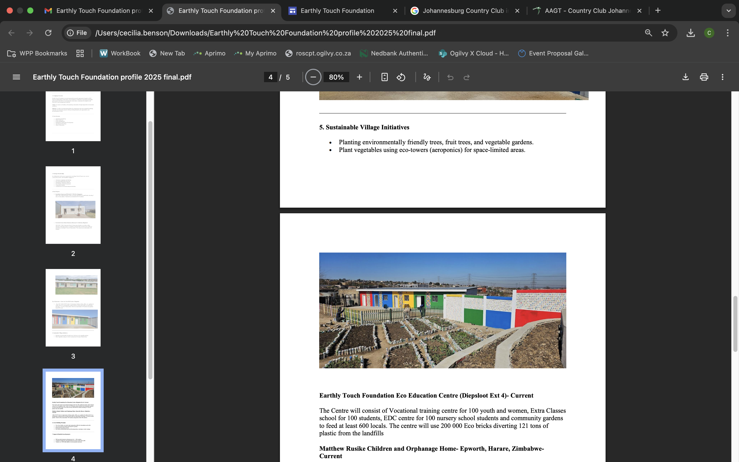
Our Impact to date
Highlights of Some Our Completed Projects
June 2025
June 2025
Eco-brick ECD school (Greater Are You, Diepsloot Ext 6)
180 m² area classroom
42 000 eco-bricks
8 000 Ecosands
23 tons waste plastic
Classroom block accommodates 100 students
35 eco-bed gardens and feeds 400 locals
Sustainable Village Initiatives, Diepsloot Ext 6)
Planting environmental friendly shade trees, fruit trees,
and vegetable gardens
Plant vegetables using eco-towers (aeroponics) for space
limited spaces

Slide 10
Our Impact
Impact and Benefits from All Projects
Provide education infrastructure for +-400 students/yearly
Creating of temporary job opportunities for local women and youth +- 100 jobs/ yearly
Training of over 2000 individuals on environmental awareness
Entrepreneurship training of +-100 students yearly
Feeding +-1000 people through our community garden projects/ yearly
Diverting 265 tons of waste plastic from the KC, ECD, Eco education centres
Safety and Compliance
Global Ecobrick Alliance (GEA) ensuring durability and
fire resistance and verified through independence testing.
Our construction partner CHERITH Projects
Chairman Colin Ekman previous company Innovation
Contractors, was accredited with NHBRC
and employs qualified construction workforce.

Slide 11
Sponsorship Partnership
Please we need your support on the journey of impact.
Project Name: Earthly Touch Foundation Eco Education Centre – Diepsloot Ext 4
Funds Needed: R2 million.
Sponsorship Opportunity:
Donate R200 000 towards a classroom construction and furniture. The classroom will be named after your organisation
Organisational scores benefits towards “sustainability” due to upcycling of waste plastic and contribution to avoiding CO₂ e emissions
Support Government policies through entrepreneurship, education and skills development (BBBEE/CSI credits)
Naming rights to the sponsored classroom with organisational branding
VIP Table for 15 guests at the Earthly Touch Foundation Gala Dinner
All sponsors will be recognised at the Gala and in all press & media coverage
R200 000 – Donate a classroom
Kindly note this sponsorship will be limited to 10x organisations

Slide 12
Ticket Sponsorship
Packages
Green Partner
Gold Partner
Earth Partner
R50 000
R25 000
R10 000
VIP Table for 15 guests
VIP Table for 10 guests
VIP Table for 5 guests
All sponsors will be recognised at the Gala and in all press & media coverage

Slide 13
Gala Tickets
Your presence and support is welcomed and appreciated.
Please join us for an amazing Gala event to raise funds for the Eco Education Centre – Diepsloot Ext 4
Kindly looking forward to an evening of making positive impact and networking with like minded leaders in the industry and communities.
R1000
Buy A Ticket
We are looking forward to hosting you.
Feel free to purchase tickets for your organisation, friends and family.

Slide 14
Other Donations
Building Materials
The following donations are also welcome
# Building materials
# Furniture for the classrooms
# Sewing Machines
# Carpentry machinery
# Gardening Equipment
# Jojo Tanks
# Stationery
Kindly looking forward to an evening of making positive impact and networking with like minded leaders in the industry and communities.
We are looking forward to hosting you.
Feel free to purchase tickets for your organisation, friends and family.

Slide 15





























Acknowledgement of partners

Slide 16


Thank You
Join us on this journey of impact. We hope that our proposal has ignited and aligned with your passion about conserving our environment and uplifting our communities.
Diana M Musara
Email address: earthlytouchfoundation@gmail.com
Cell: 082 900 2329
Josephine Sidambe
Email address: earthlytouchfoundation.js@gmail.com
Cell: 071 382 51115
Contact Details
Banking Details
Earthly Touch Foundation
Name of bank: First National Bank
Account number: 62868726814
Branch: 210835 Reference: Name & Surname
Web: www.earthlytouchfoundation.com
Email: earthlytouchfoundation@gmail.com
@earthlytouchfoundation
earthlytouchfoundation

